Slide 1
Compiler Design Lexical Analyzer
Presented By:
Dr. Bhawana Tyagi

Slide 2
Lexical Analysis
It reads the source program one character at a time and translate it into a sequence of primitive units called tokens.
For each lexeme, the lexical analyzer produces as output a token of the form <token-name, attribute-value> that it passes on to the subsequent phase, syntax analysis.
In the token,
the first component token-name - abstract symbol that is used during syntax analysis, and
the second component attribute-value - points to an entry in the symbol table for this token.

Slide 3
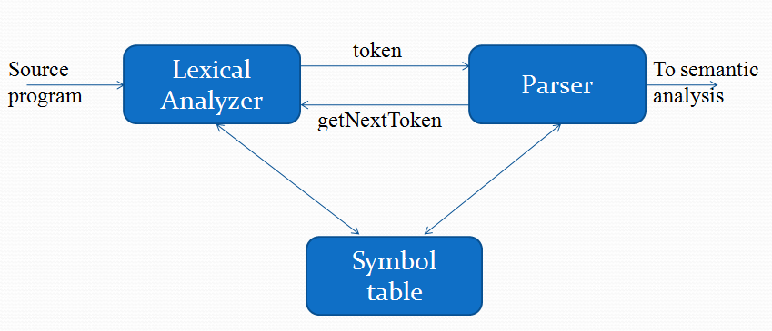
Role of Lexical Analyzer

Slide 4
Roles of Lexical Analyzer
Token Generation
Keeping track of line number
Stripping out white space
Deleting comments

Slide 5
Tokens, Patterns and Lexemes
A token consists of a token name and an optional attribute value. The token name is an abstract symbol representing a kind of lexical unit, e.g., a particular keyword, or a sequence of input characters denoting an identifier. The token names are the input symbols that the parser processes.
A pattern is a description of the form that the lexemes of a token may take. In the case of a keyword as a token, the pattern is just the sequence of characters that form the keyword. For identifiers and some other tokens, the pattern is a more complex structure that is matched by many strings.
A lexeme is a sequence of characters in the source program that matches the pattern for a token and is identified by the lexical analyzer as an instance of that token.

Slide 6
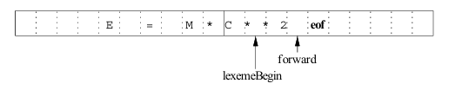
pair of input buFFer
Two pointers to the input are maintained:
Pointer lexemeBegin, marks the beginning of the current lexeme, whose extent we are attempting to determine.
Pointer forward scans ahead until a pattern match is found;
Once the next lexeme is determined, forward is set to the character at its right end. Then, after the lexeme is recorded as an attribute value of a token returned to the parser, lexemeBegin is set to the character immediately after the lexeme just found.

Slide 7
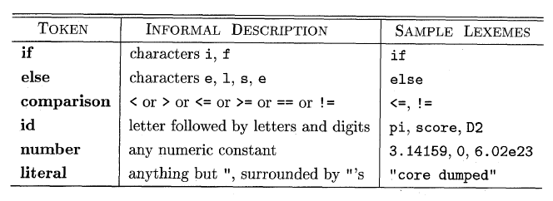
Example of tokens

Slide 8
How can we design Lexical Analysis?
First - We need some method of describing the possible tokens that can be encounter or appear in the input stream (for this regular expression is used).
Second - we need to decide what the tokens are, so we need the mechanism to recognize these tokens in the input stream (for this transition diagram and finite automata is used).

Slide 9
Specification of Tokens
Strings and Languages
Operations on Languages
Regular Expressions
Regular definition

Slide 10
1. Strings and Languages
STRING
A string over an alphabet is a finite sequence of symbols drawn from that alphabet.
The length of a string s, usually written |s|, is the number of occurrences of symbols in s. Ex: banana is a string of length six. The empty string, denoted 𝛆, is the string of length zero.
LANGUAGE
A language is any countable set of strings over some fixed alphabet. Abstract languages like 0, the empty set, or {𝛆}, the set containing only the empty string, are languages under this definition. So

Slide 11
Terms for Parts of Strings
The following string-related terms are commonly used:
1. A pre x of string s is any string obtained by removing zero or more symbols from the end of s. For example, ban, banana, and are prefixes of banana.
2. A suffix of string s is any string obtained by removing zero or more symbols from the beginning of s. For example, nana, banana, and are suffixes of banana.
3. A substring of s is obtained by deleting any pre x and any suffix from s. For instance, banana, nan, and are substrings of banana.
4. The proper prefixes, suffixes, and substrings of a string s are those, prefixes, suffixes, and substrings, respectively, of s that are not ϵ or not equal to s itself.
5. A subsequence of s is any string formed by deleting zero or more not necessarily consecutive positions of s. For example, baan is a subsequence of banana

Slide 12
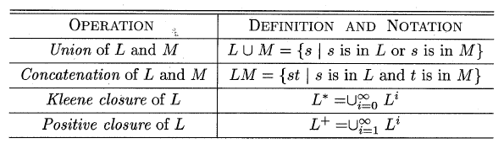
2. Operations on Languages

Slide 13
Regular Expression
Each regular expression denotes a language.
Rules for construction :
ϵ is a regular expression, the language containing only empty string.
For each ‘a’ in ∑, a is a regular expression denoting {a}, the language with only one string.
If A and B are regular expression denoting language L_{A}UL_{B} then:
(A)|(B) is a regular expression denoting L_{A} UL_{B}
A.B is a regular expression denoting L_{A}.L_{B}
(A)* is a regular expression denoting L_{A}*

Slide 14
Describe the languages denoted by the following regular expressions:
a) a(a|b)*a.
b) (a|b)*a(a|b)(a|b).
c) a*ba*ba*ba* .
d) (aa|bb)*((ab|ba)(aa|bb)* (ab|ba)(aa|bb)*)*

Slide 15
Write regular definitions for the following languages:
All strings of lowercase letters that contain the five vowels in order.
All strings of lowercase letters in which the letters are in ascending lexicographic order.
All strings of a's and b's that do not contain the subsequence abb.

Slide 16
Solution
All strings of lowercase letters that contain the five vowels in order.
s -> C* a (C|a)* e (C|e)* i (C|i)* o (C|o)* u (C|u)*
C -> [bcdfghjklmnpqrstvwxyz]
All strings of lowercase letters in which the letters are in ascending lexicographic order. a* b* ... z*
All strings of a's and b's that do not contain the subsequence abb.
b* | b*a+ | b*a+ba*

Slide 17
Implementation of Lexical Analyzer
Construct NFA for each token pattern Pi in the translation rule, then link these NFA’s together with a new start state.
Convert NFA to DFA using Subset construction.
State Minimization
Implement the look ahead operator
Representing a transition diagram as a data structure.

Slide 18
THANK YOU

